Slide 1
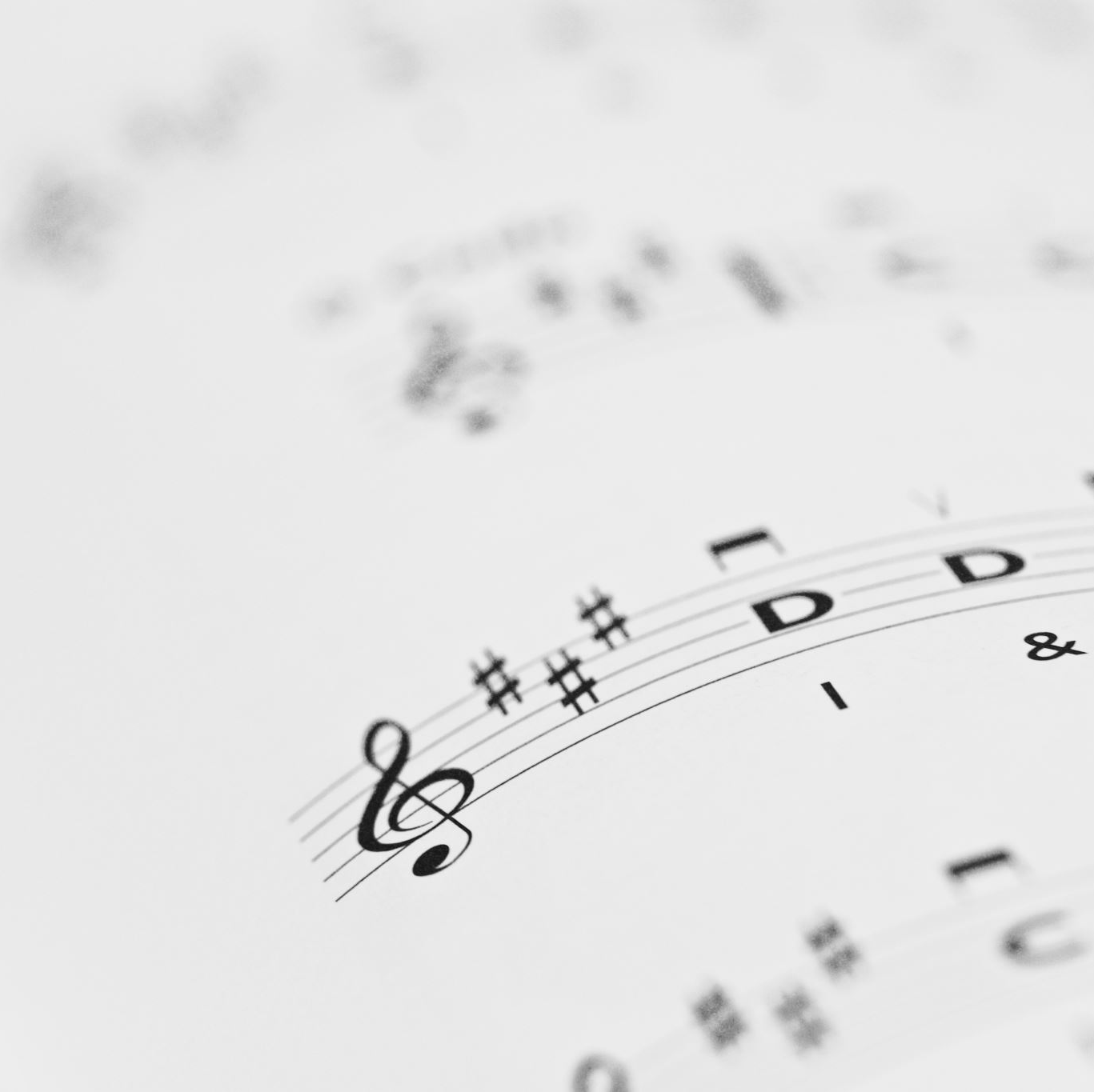
Analyzing Attributes of Songs by Decades
Jen Krizman, Valentina Villarroel, Roxanne Meyer

Slide 2
Agenda
Background
Data
Tasks

Slide 3
Background
We wanted to analyze the attributes of a representative list of songs for a decade vary across the decades (50s – 00s), and display in a digestible dashboard.

Slide 4
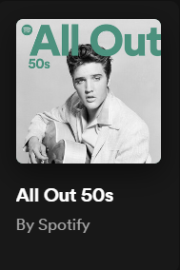
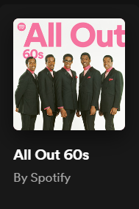
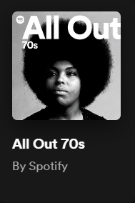
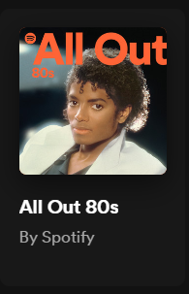
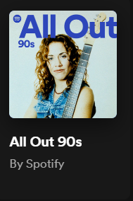
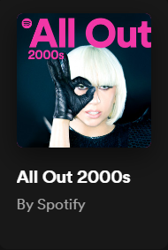
Data
Utilized Spotify’s “All Out [Decade]” for ‘50-’00s as the top 150 songs per decade
Queried the following attributes of the songs to model, then refined:
Acousticness
Danceability
Energy
Key
loudness
Instrumentalness
Mode
Valence
Speechiness

Slide 5
Tasks
create an interactive dashboard that draws from Spotify’s web API.
Utilize cURL to import playlist information
Utilize python to extract song ids
Utilize SQLite to manipulate the extracted information
Create an HTML/CSS page with JavaScript code to create an interactive, user-driven dashboard
include a Python Flask-powered API
Additional JS Library

Slide 6

Data (Cont.)
Source: https://developer.spotify.com/documentation/web-api/reference/get-audio-features
Acousticness: no acoustic [0,1] all acoustic
Danceability: least danceable [0,1] most danceable
Energy: low intensity [0, 1] high intensity
Key: [0, 11]* starting in C (no key is -1)
Loudness: not loud [-60,0] very loud
Acousticness: .202 – low
Danceability: .759 – very danceable
Energy: .699 – moderately high energy
Key: 0 - C
Loudness: -5.745 – portions are very loud

Slide 7
Data (Cont.)
Instrumentalness: lots of vocal [0, 1] no vocals
Mode: minor= 0, major = 1
Valence: sad-sounding [0, 1] happy-sounding
Speechiness: no speech [0,1] lots of speech
Instrumentalness: . 0.000131 – almost all vocals
Mode: 0 – minor key
Valence: 0.907 – happy or upbeat
Speechiness: 0.0307 – many more music layers than speech

Slide 8
Dashboard Demo

Slide 9
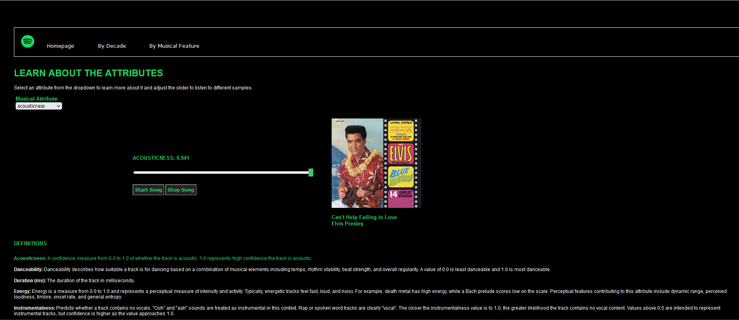
Visualizations and Analysis (pt.1)

Slide 10
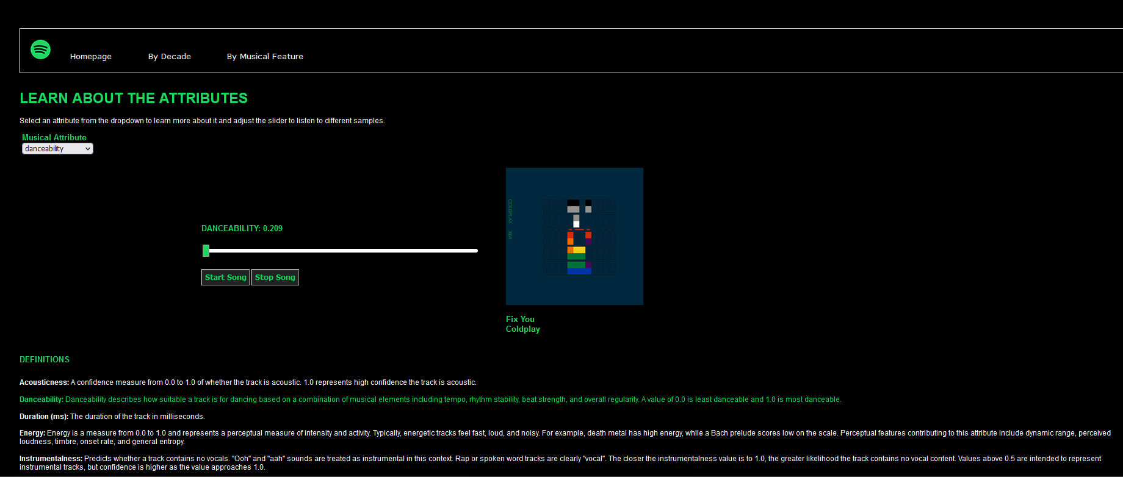
Visualizations and Analysis (pt. 2)

Slide 11
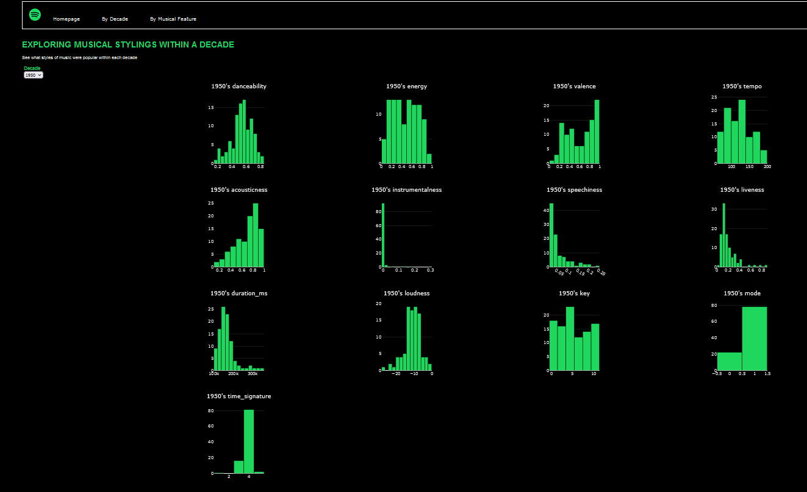
Visualizations and Analysis (pt. 3)

Slide 12
Questions and Answers

Slide 13
Thank you

